Slide 1
Rules for Covid
Keep the distance of one metre
In classroom, always keep the mask, lower it only if you drink or eat a snack
Cough or sneer into a disposable
Greet without shaking hands, always sanitize your hands
Don’t go to school if you have a fever.
Remember to put a spare mask in your school bag
Report any malaise to the teacher
Do not share school materials
Ventilate the classroom
Finish

Slide 2
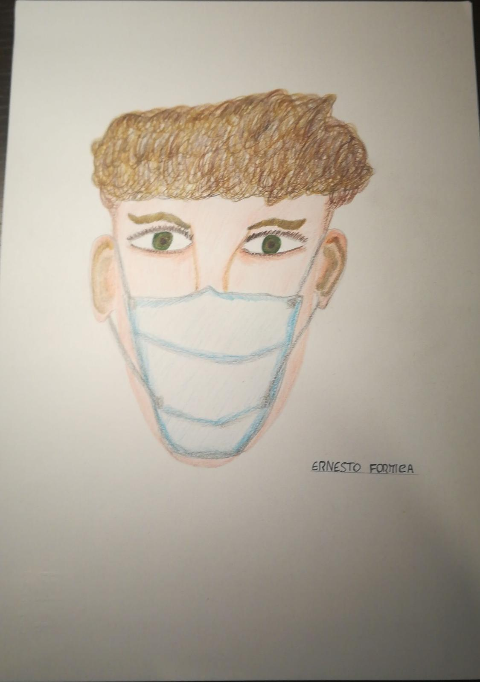
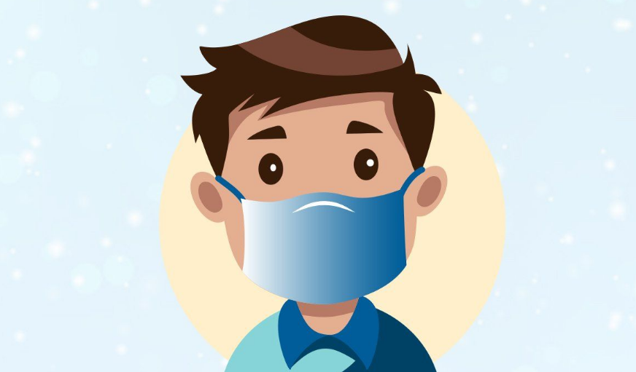
I recommend it:
use the mask!
Go Back

Slide 3
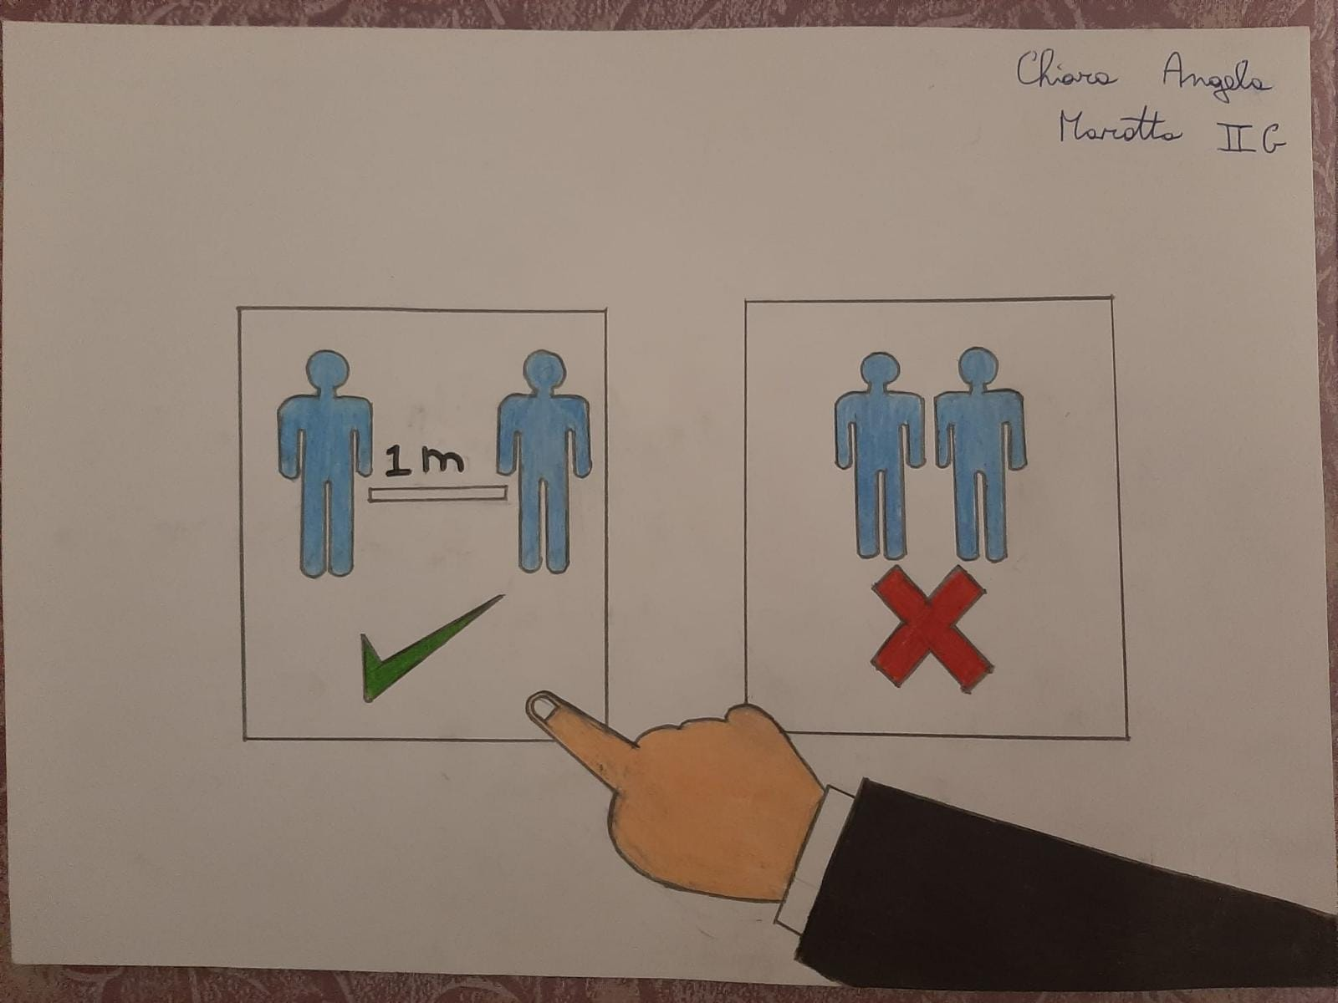
If you want, you can keep two metres of distance (better than one)

Slide 4
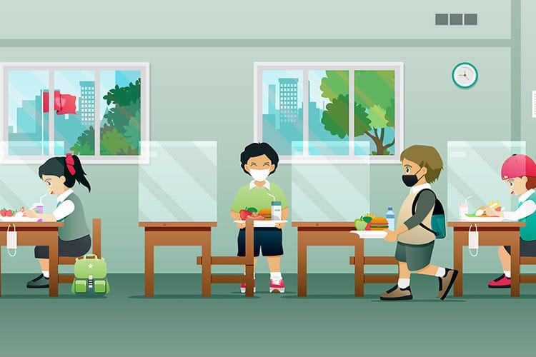
The solution is easy: don’t eat and don’t drink!

Slide 5
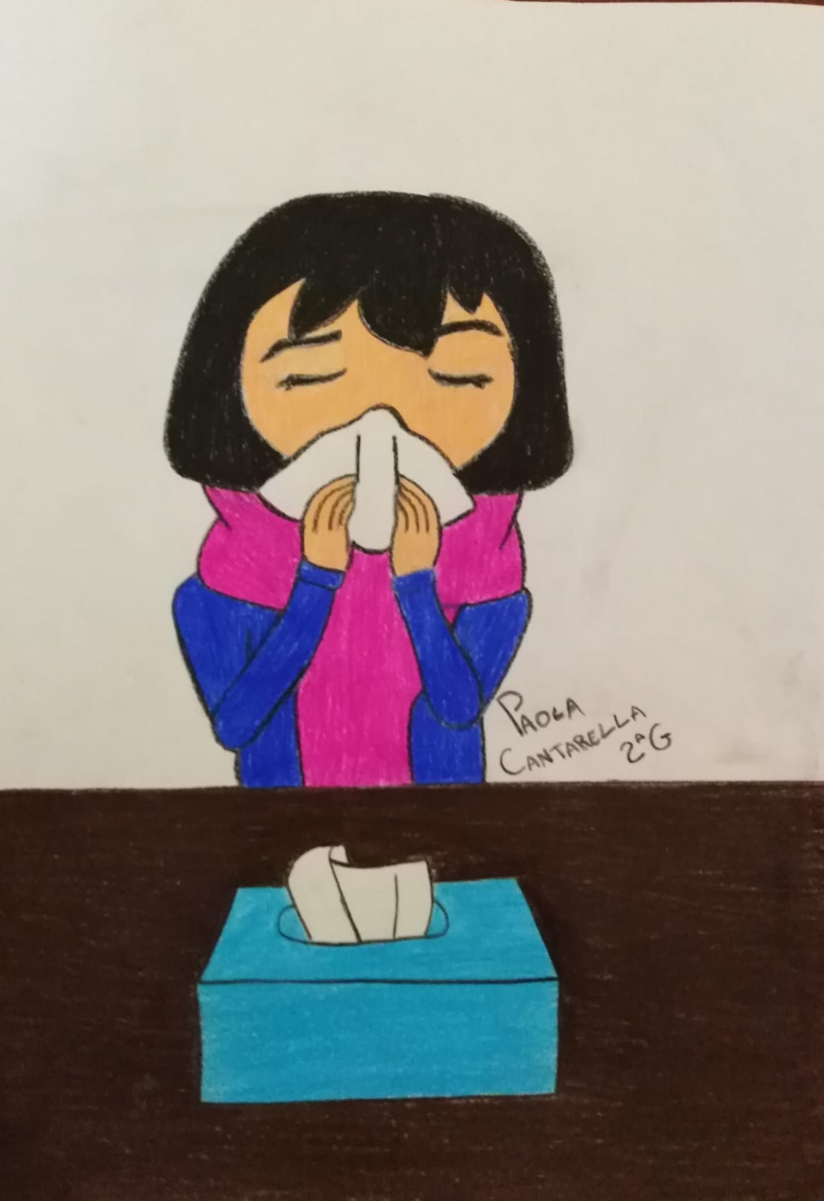
After you use the disposable, throw it

Slide 6
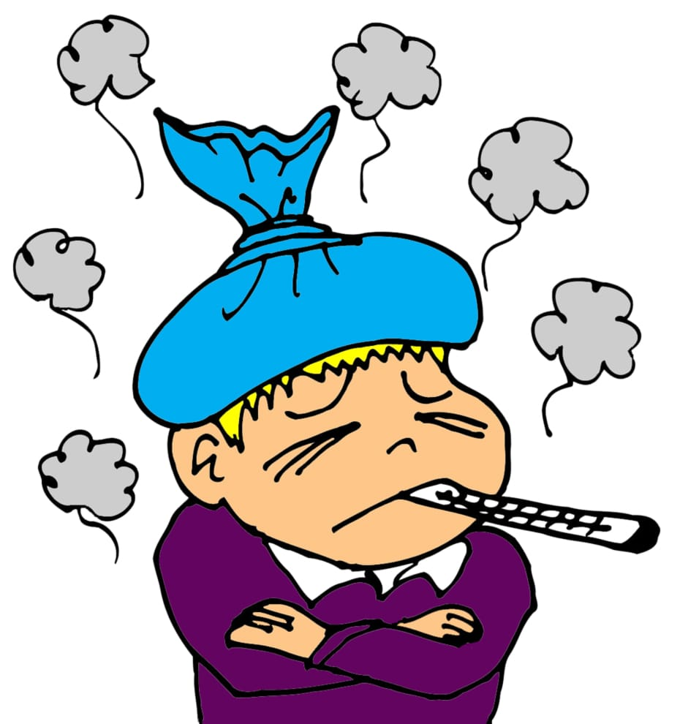
Always measure your fever when you wake up

Slide 7
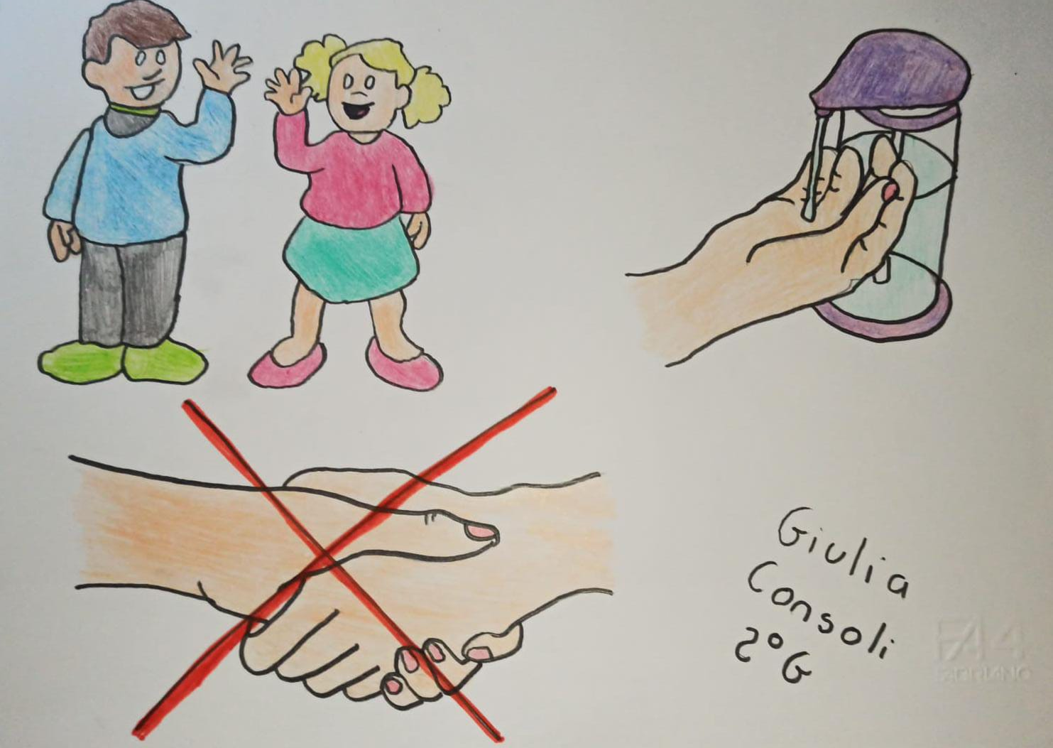
Don’t hug
today to hug tomorrow

Slide 8
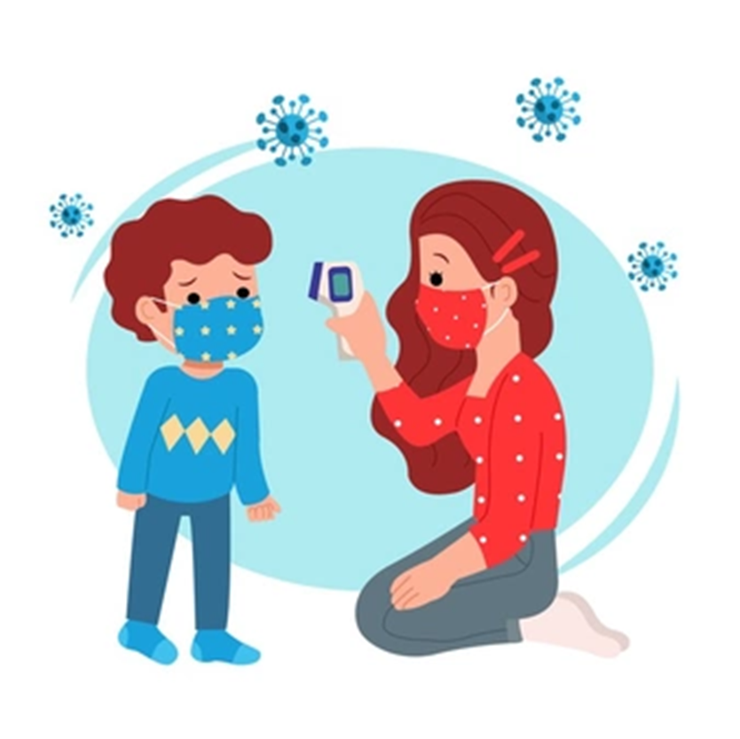
Don’t do the hero. Report your malaise for you and the other people

Slide 9
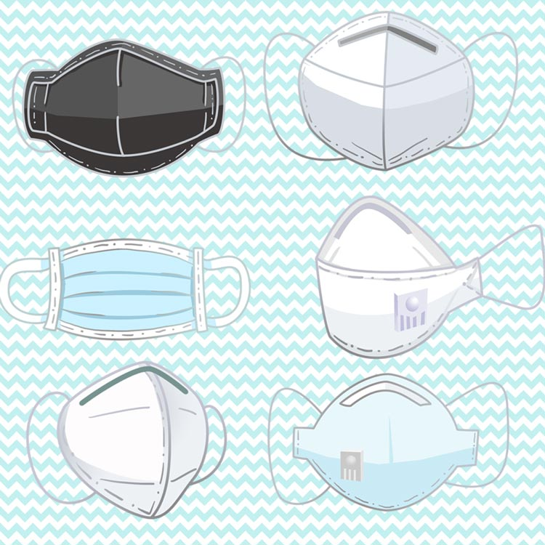
As you don’t forget the phone at home, don’t forget the spare mask

Slide 10
It is not the right time to share school materials: be patient!

Slide 11
Open the windows is necessary for everyone’s health

Slide 12
Scuola Media Statale «Mario Pluchinotta»
2G
Disegni realizzati da: Cantarella Paola, Consoli Giulia, Formica Ernesto, Marotta Chiara
Power point realizzato da: Alberti Dario, Cantarella Federica, Cavallaro Sergio

