Slide 1
COVID REGULATIONS

Slide 2
1) Don't go to school if you have a fever.
2) Put on the mask before entering the classroom.
3) Remember to put a spare mask in your backpack.
4) keep distances of one meter.
5) Greet without straining your hand and often sanitize your hands.
6) In class, keep the mask and lower it if you drink or eat a snack.
7) Coughing or sneezing into a disposable handkerchief.
8) Do not share school materials.
9) Ventilate the classroom.
10) Report any malaise to the teacher.

Slide 3
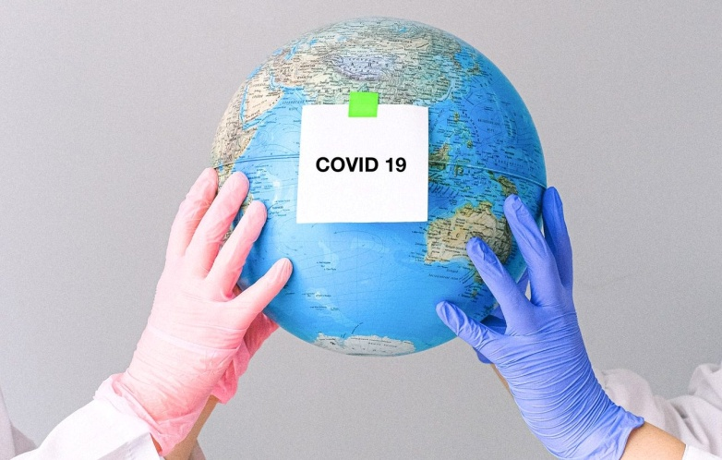
REGLEMENT COVID
1) Ne pas aller à l'école si vous avez de la fièvre.
2) Mettre le masque avant d'entrer dans la classe.
3) Ne pas'oublier de mettre un masque de rechange dans votre sac à dos.
4) Garder des distances d'un mètre.
5) Saluer sans forcer votre main et désinfectez souvent vos mains.
6) En classe, garder le masque et baissez-le si vous buvez ou mangez une collation.
7) tousser ou éternuer dans un mouchoir jetable.
8) Ne pas partager le matériel scolaire.
9) Aérer la salle de classe.
10) Signaler tout malaise à l'enseignant.

Slide 4
WHAT IS THE DIFFERENCE BETWEEN ISOLATION AND QUARANTINE ?
The isolation of cases of documented SARS-COV-2 infection refers to the separation of infected people from the rest of the community for the duration of the period of contagiousness, in an environment and conditions that prevent the transmission of the infection.
quarantine, on the other hand, refers to the restriction of the movement of healthy people for the duration of the incubation period but who may have been to an infectious agent or a contagious disease, with the aim of monitoring the possible appearance of symptoms and identifying timely new cases.

Slide 5
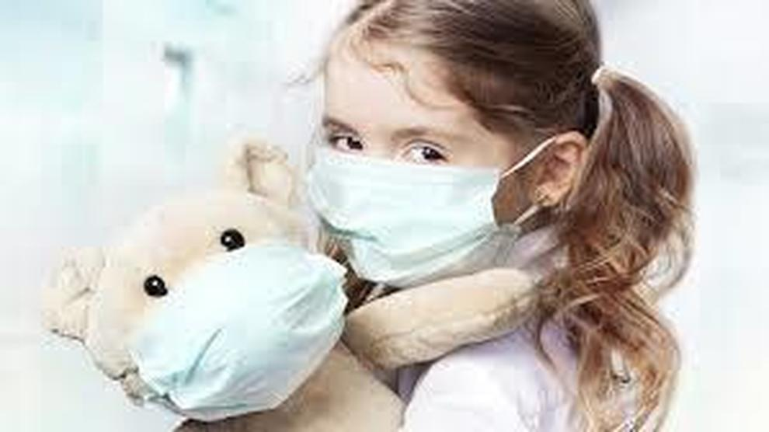
IF A PUPIL, OR SCHOOL WORKER,IS LIVING WITH AN ESTABLISHED SARS-COV-2 CASE, MUST HE BE PLACED IN QUARANTINE?
YES, it must be placed in quarantine upon evaluation by the Prevention Department. Any close contacts (for example classmates of the pupil in quarantine) do not require quarantine, unless further assessments by the Department of Prevention.

Slide 6
IN THE EVENT THAT A STUDENT IS PLACED IN COMPULSORY OR FIDUCIARY HOME ISOLATION,IS THE ISOLATION EXTENDED TO ALL CO-LIVING RELATIVES?
Yes, if the student is positive.
no, in case he is in quarantine because the classmate (close contact) has tested positive for covid.

Slide 7
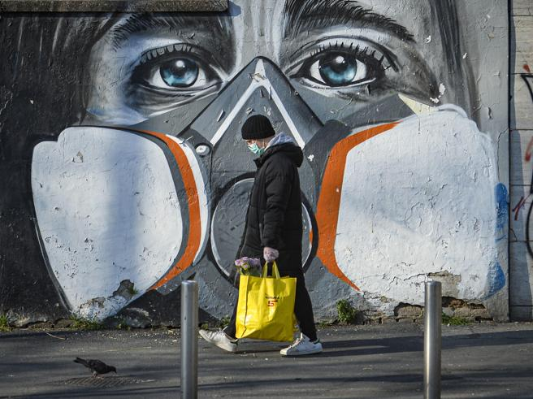
DO CHILDREN/TEENAGERS HAVE TO WEAR A MASK AT SCHOOL?
As a result of the DPCM of 3/11/2020, the didactic and educational activity for kindergarten, the first cycle of education and for the educational services for children continues to take place in the presence, with the mandatory use of masks except for children under the age of 6 and for those with pathologies or disabilities incompatible with the use of the mask.

Slide 8
3L
GIORDANA MAUCERI
DANIELA SCONZO
ALESSIA NOTO
MARTINA D’ALESSANDRO

