Slide 1
Anticovid Norms
By Anna

Slide 2
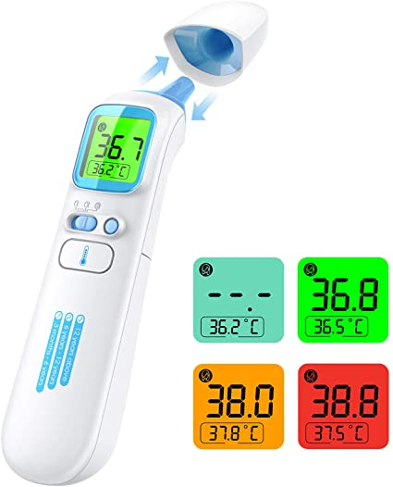
Don’t go to school if you catch a fever.
If the temperature goes above 37.5 call your doctor

Slide 3
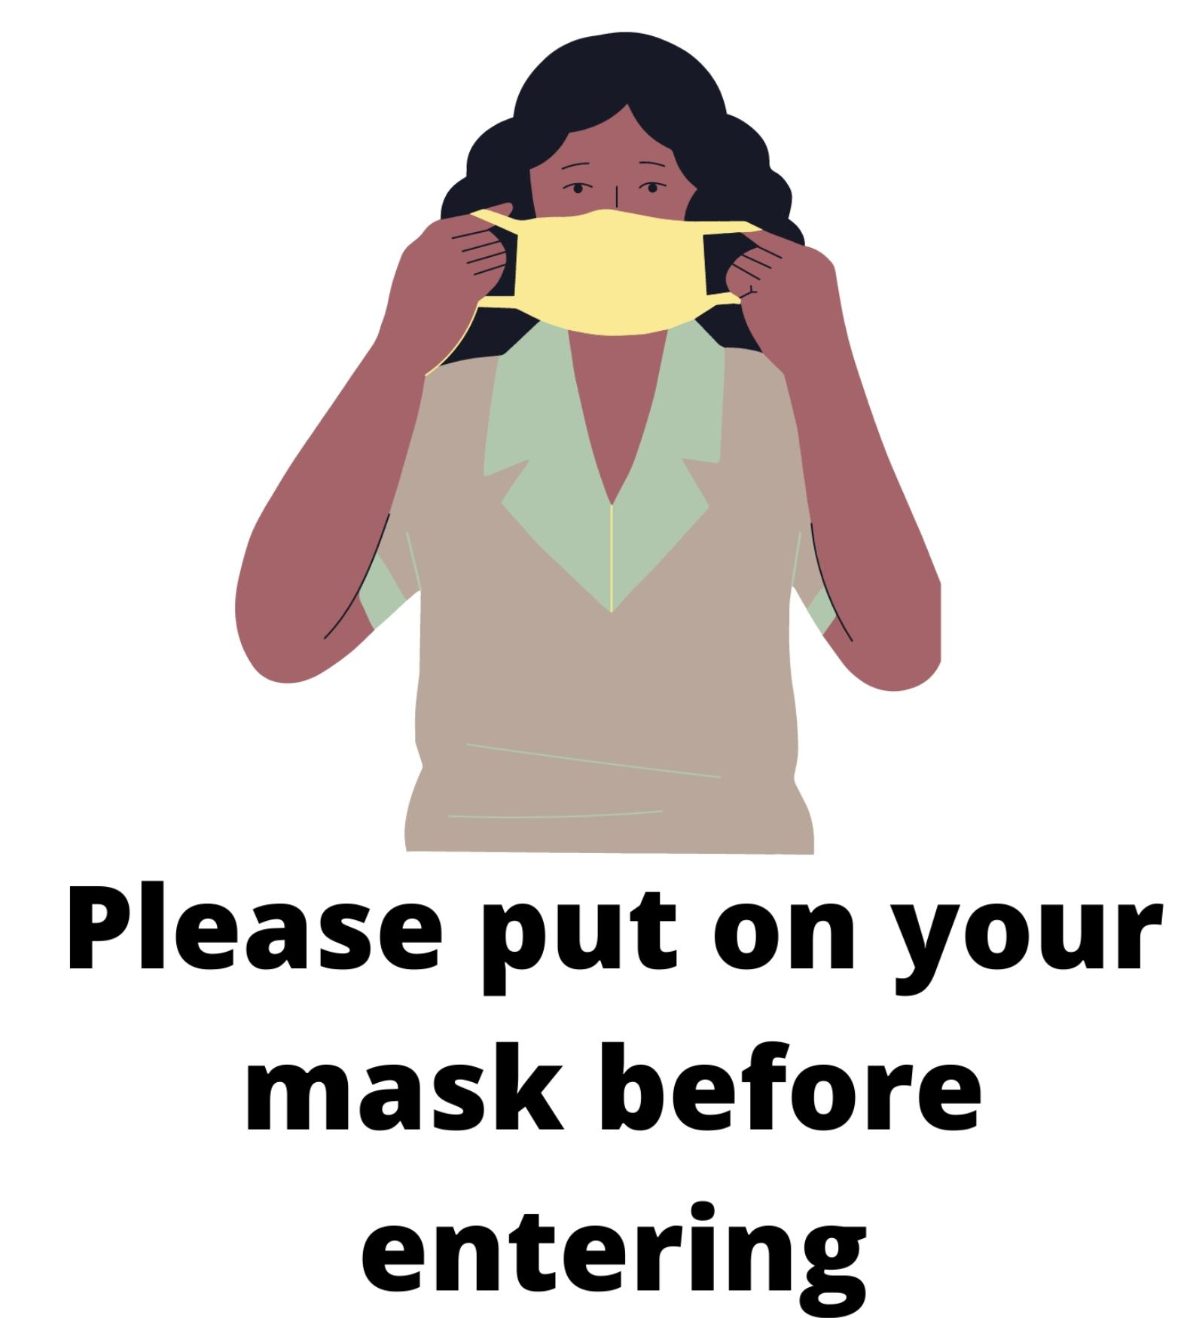
Put on the mask before entering into the school.

Slide 4
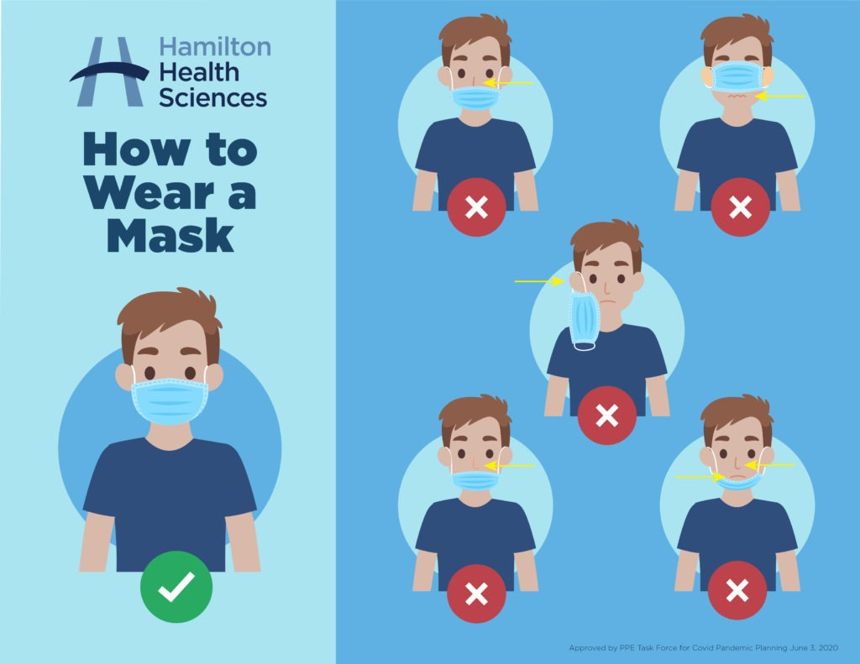
Remember to put a spare mask in your backpack.

Slide 5
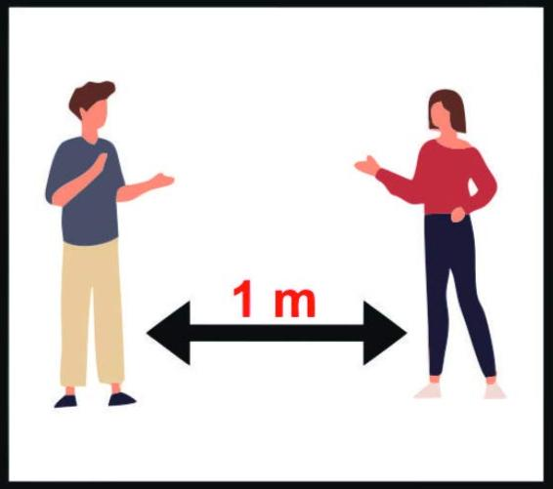
Keep the distance of 1 m.

Slide 6
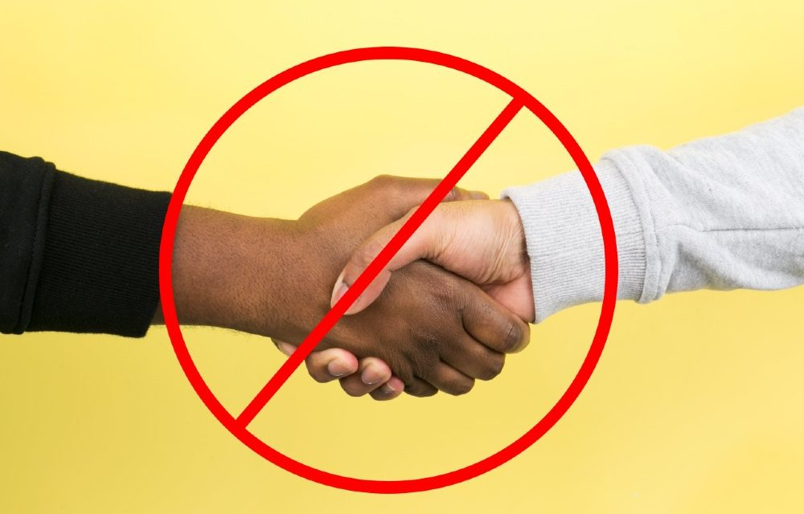
Greet without shaking hands.

Slide 7
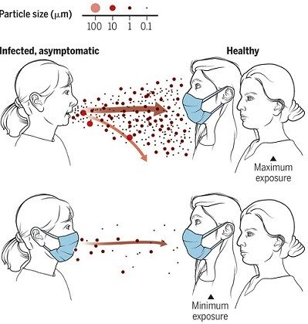
Always keep the mask but lower it only when you eat or drink.

Slide 8
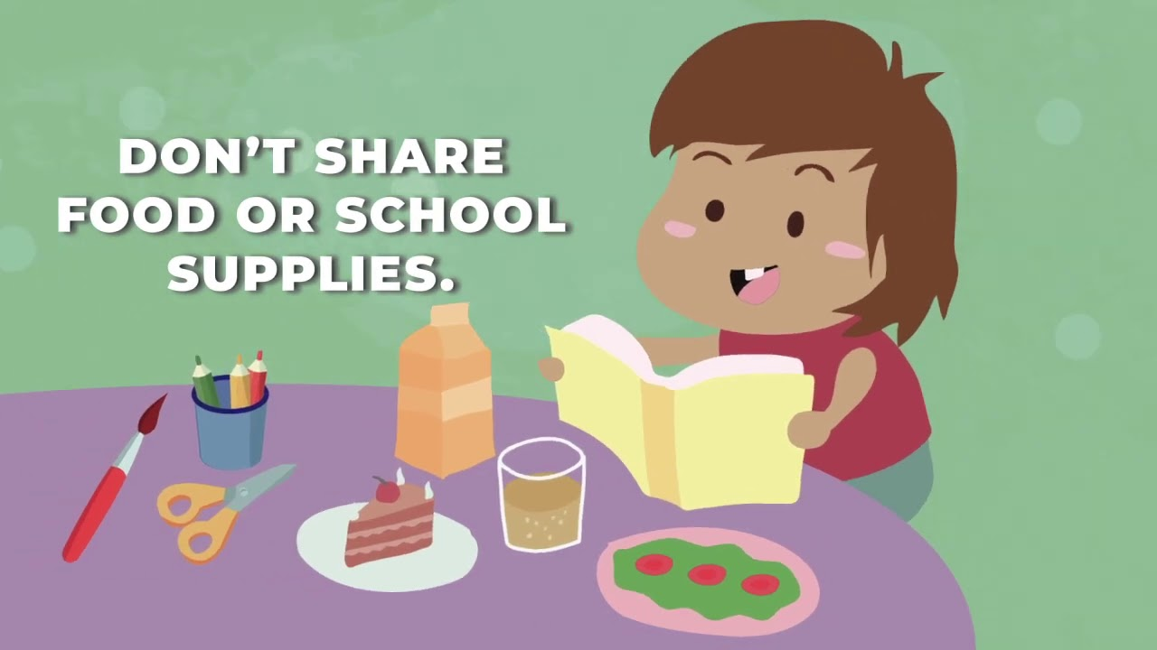
Don’t share school supplies with each other.

Slide 9
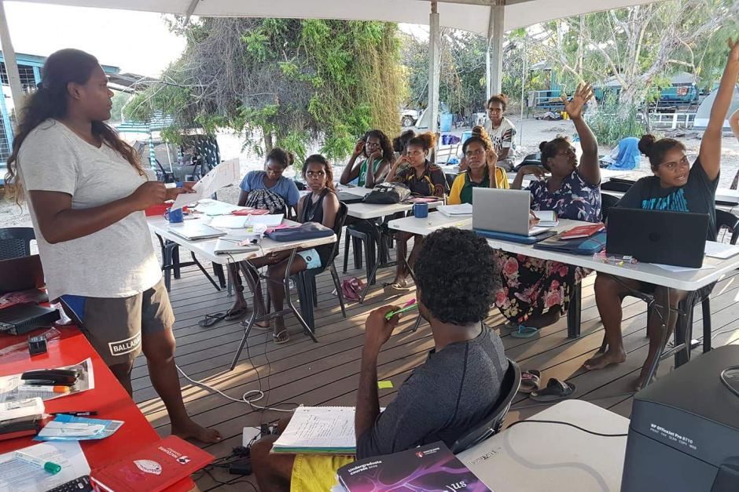
Air the class.

Slide 10
Report any discomforts to the teacher.

